Slide 1

23AID305 – CONTROL SYSTEM Review 2
Learning-Based Model Predictive Control for Multi-Room Energy Incident Management in
Smart Hospitals Using Cloud Services
Team 9 :
Gowtham SD : CB.AI.U4AID23113
Guhan K B : CB.AI.U4AID23114
Vaishnavi Gupta : CB.AI.U4AID23149
Vyshnav Kumar S : CB.AI.U4AID23151

Slide 2
Contents
Introduction
Problem statement
Objective
Methodology
Progress
References

Slide 3
Introduction
Hospitals require reliable energy and thermal management to maintain patient safety and comfort.
Traditional systems lack adaptability, prioritization, and cloud-based remote access.
This project uses Learning-Based Model Predictive Control (LB-MPC) to manage HVAC across multiple hospital zones.
Real-time data is sent to the cloud for monitoring, visualization, and remote updates, ensuring intelligent and scalable control.

Slide 4
Problem statement
Existing hospital EMS systems are limited by hardware dependency and lack priority-based energy allocation across critical zones.
Conventional MPC approaches rely on static or data-hungry models, reducing accuracy under dynamic conditions.
Current systems lack scalability and cloud-based intelligence needed for real-time, adaptive multi-room energy management.

Slide 5
Objective
Simulate real-time hospital energy demand across zones with different priorities.
Optimizes energy dispatch considering battery state-of-charge and grid limits.
Provides an interactive, dashboard for remote control and monitoring.
Operates fully in the cloud without hardware dependencies.

Slide 6
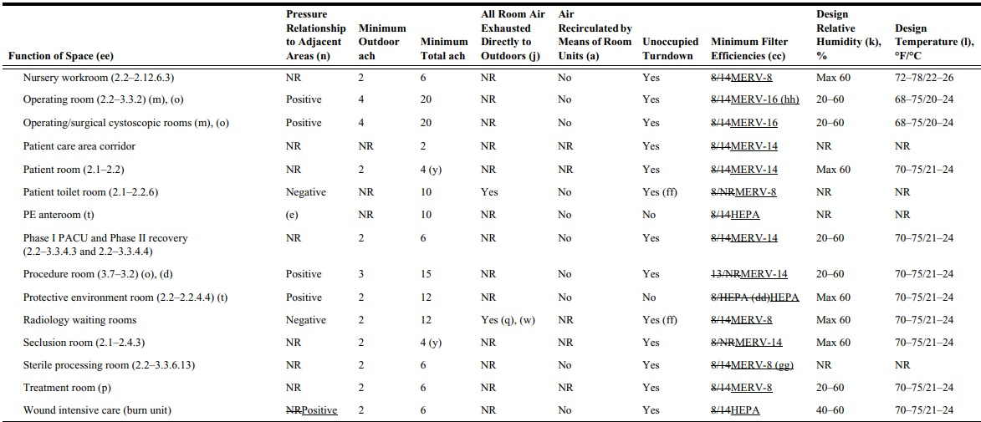
EXTRA – LITERATURE REVIEW
Approved by ASHRAE Standards Committee on July 31, 2020; by the ASHRAE Board of Directors on August 10, 2020; by the American Society for Health Care Engineering on July 28, 2020; and by the American National Standards Institute on September 1, 2020.

Slide 7
Methodology
1. Thermal and Electrical Modeling of Hospital Zones (DONE)
Develop RC thermal models for individual hospital rooms.
Simulate temperature variations and HVAC-driven energy usage.
Incorporate electrical load profiles for each room based on lighting, equipment, and occupancy.
2. Power Grid and EMS Simulation (DONE)
Model a power grid supplying energy to hospital zones and HVAC systems.
Integrate an EMS block to monitor and manage room-level energy consumption.

Slide 8
Methodology
3. Data Acquisition Layer (DONE)
Collect real-time data from sensors across hospital zones (temperature, power usage).
Gather grid status, load profiles, and HVAC system activity.
Send data to both the cloud and EMS block for control and analysis.
4. Forecasting Module
Predict ambient temperature and power availability using time-series models.
Feed predictions into the cloud to assist LB-MPC in disturbance-aware control.
Enable proactive decision-making under uncertain conditions.

Slide 9
Methodology
5. Cloud Integration
Act as a central hub for data storage, forecast distribution, and control coordination.
Log real-time system states and performance metrics.
Interface with the forecasting module and deliver inputs to the LB-MPC.
6. Learning-Based MPC (LB-MPC) Control
Optimize HVAC and energy control actions using forecast and real-time inputs.
Maintain thermal comfort while minimizing energy consumption and respecting grid limits.
Use reinforcement learning to adaptively improve control policy over time.

Slide 10
IEEE 14-Bus System with Hospital Zones
Load IEEE 14-Bus System
Use MATLAB/Simulink (Simscape Electrical) or MATPOWER to load the network.
Select 4-6 Buses for Hospital Zones
Assign each to a hospital department based on criticality.
Replace Default Loads with Custom Hospital Models
Run Simulations and observe power flow, HVAC switching, and zone-wise temperature profiles.

Slide 11
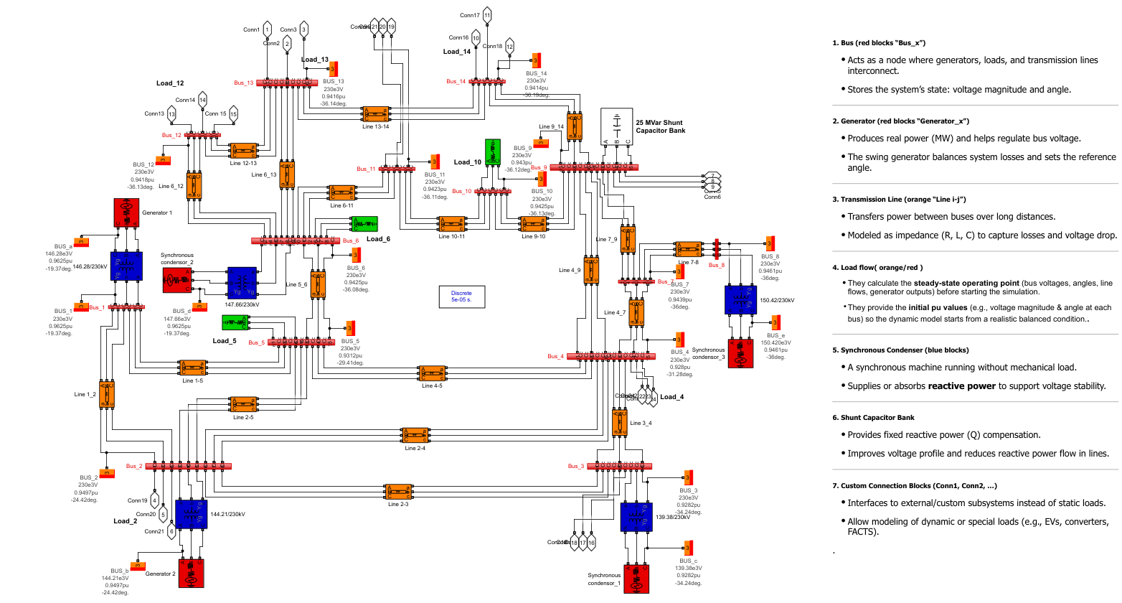
IEEE 14 Bus System

Slide 12


Single-zone model design
Connect your hospital zone model to the selected bus in IEEE 14-bus
Add Constant PQ Load block for lights, equipment, and baseline consumption.
Thermal RC Model: Use integrators & gains:
Add a Controlled Resistor/Heater or AC model representing HVAC demand.
Connect to HVAC Switch for ON/OFF control.
Thermostat Controller:

Slide 13
Adaptation for Each Zone
Priority 1 (ICU, OT):
Keep HVAC ON as long as possible.
Use narrow temperature band (e.g., 24°C) for stricter control.
Allow higher power usage threshold before shedding.
Priority 2 (Emergency, Critical Care):
Similar structure, but slightly wider temperature band (25°C).
HVAC can be shed after Priority 1 zones during shortages.

Slide 14
Priority 3 (General Wards)
Same blocks but use even wider band (26°C).
Shedding happens before Priority 1 & 2.
Priority 4 (Admin Offices)
Exact same block setup.
Comfort range can be broad (28°C) since patient care isn’t directly affected.

Slide 15
Room loads used
ICU : P = 15000 W, QL = 7265 var, Qc = 0 (pf ≈ 0.90) & Temp Gain - 60
Emergency / Critical Care: P = 12000 W, QL = 5112 var, Qc = 0 (pf ≈ 0.92) & Temp Gain - 50
General Ward: P = 8000 W, QL = 2629 var, Qc = 0 (pf ≈ 0.95) & Temp Gain - 40
Admin / Offices: P = 5000 W, QL = 1015 var, Qc = 0 (pf ≈ 0.98) & Temp Gain - 30

Slide 16
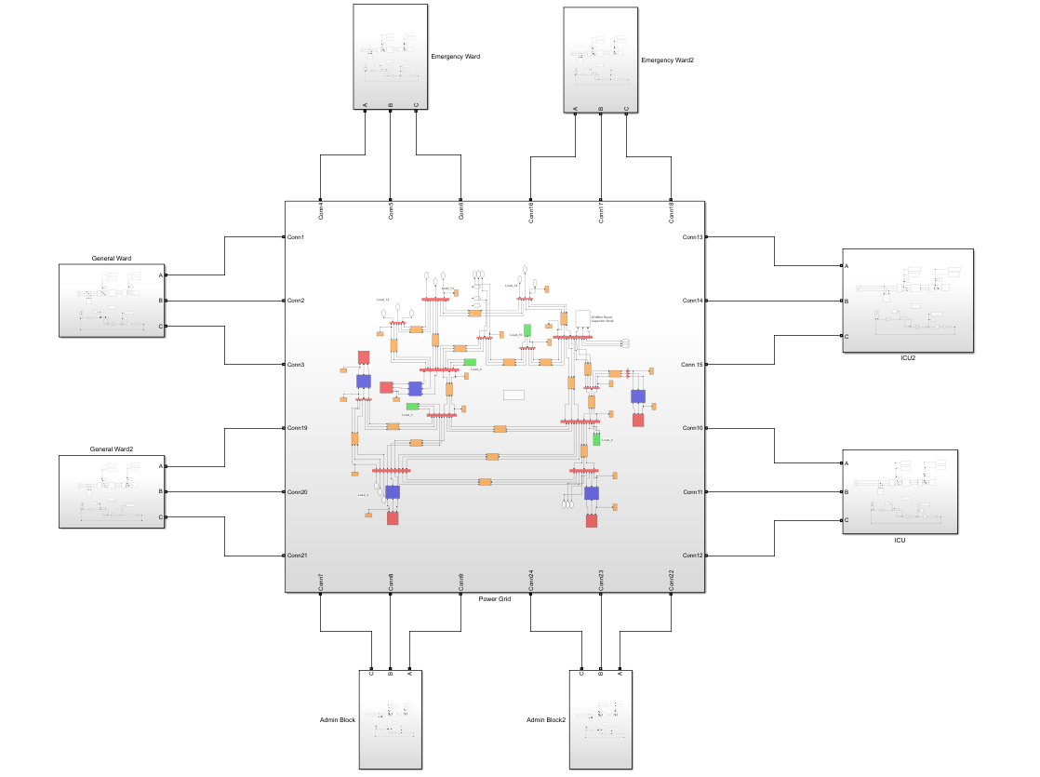
RESULTS - OVERALL
The Room models are integrated with the bus system successfully.
8 Rooms in total : 2 ICU
2 Emergency Ward
2 General Ward
2 Admin Block

Slide 17
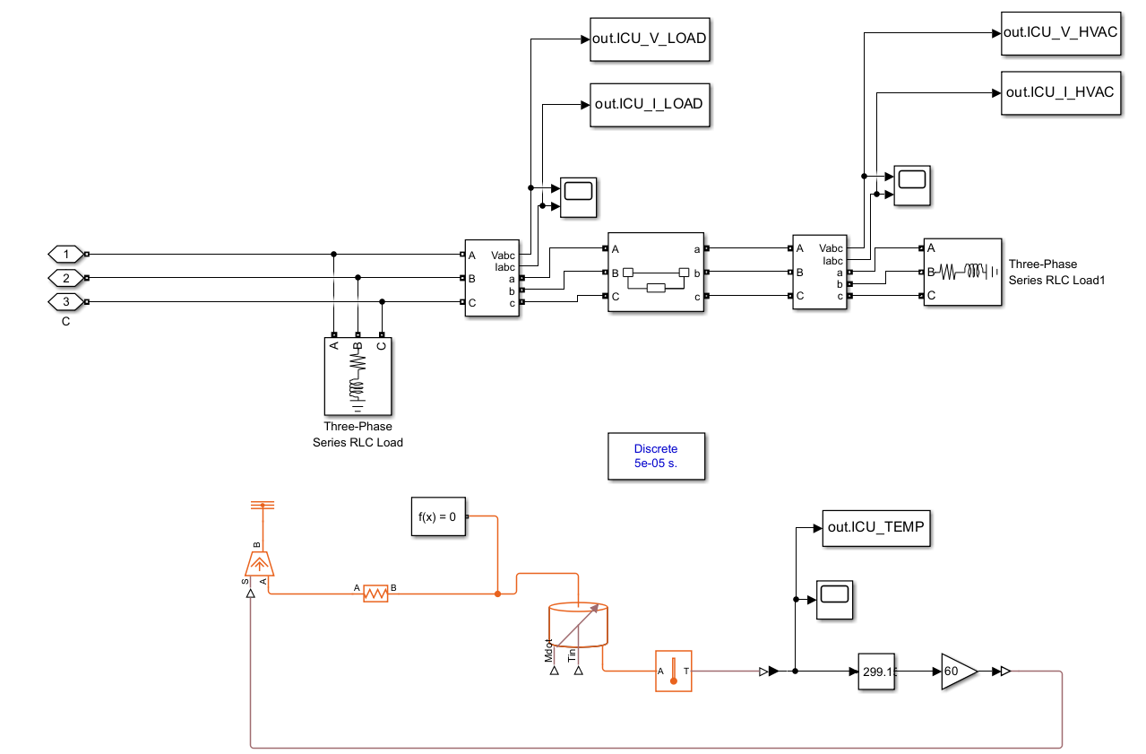
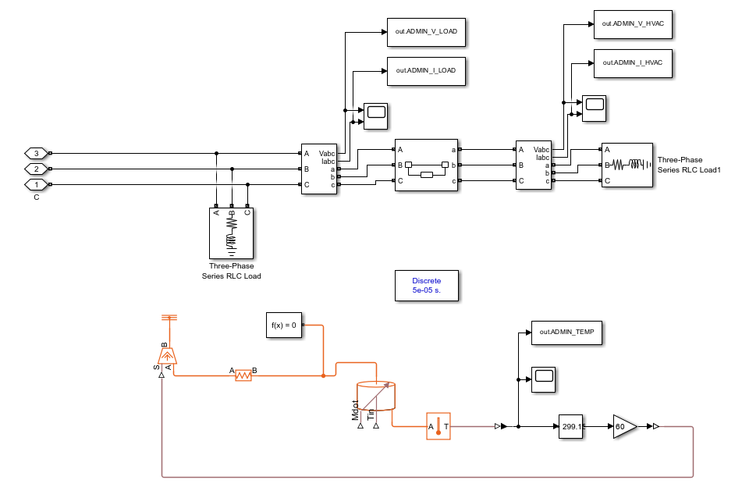
RESULTS - ROOMS
ICU ROOM ADMIN ROOM

Slide 18
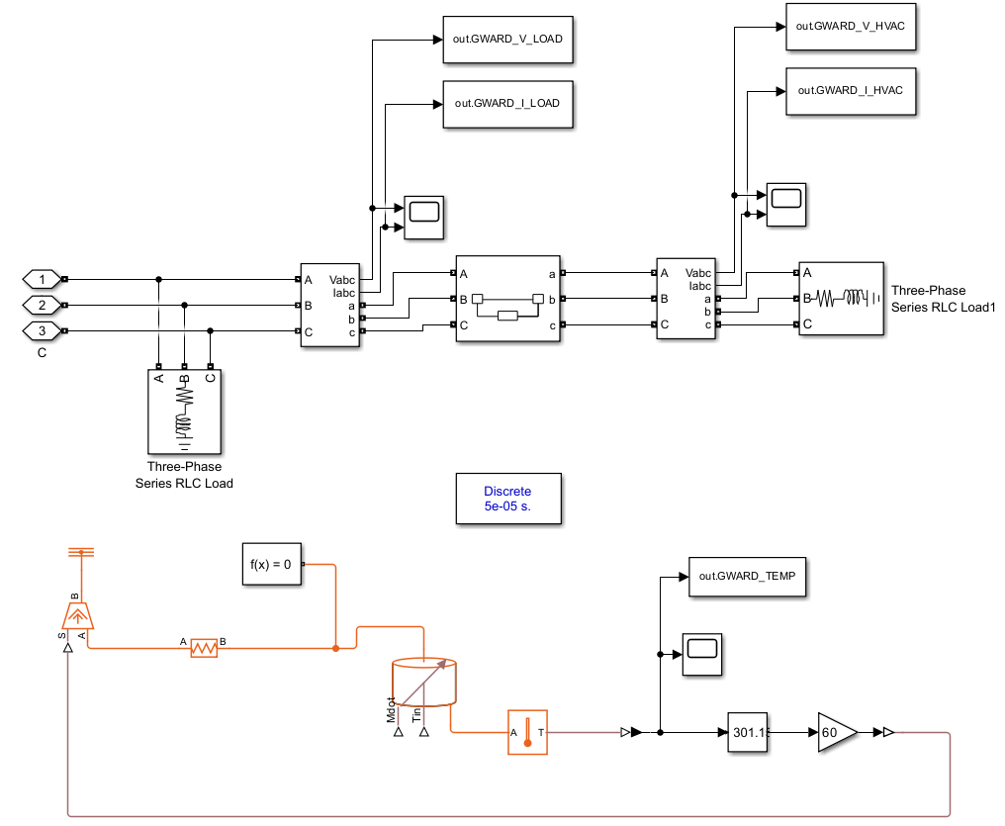
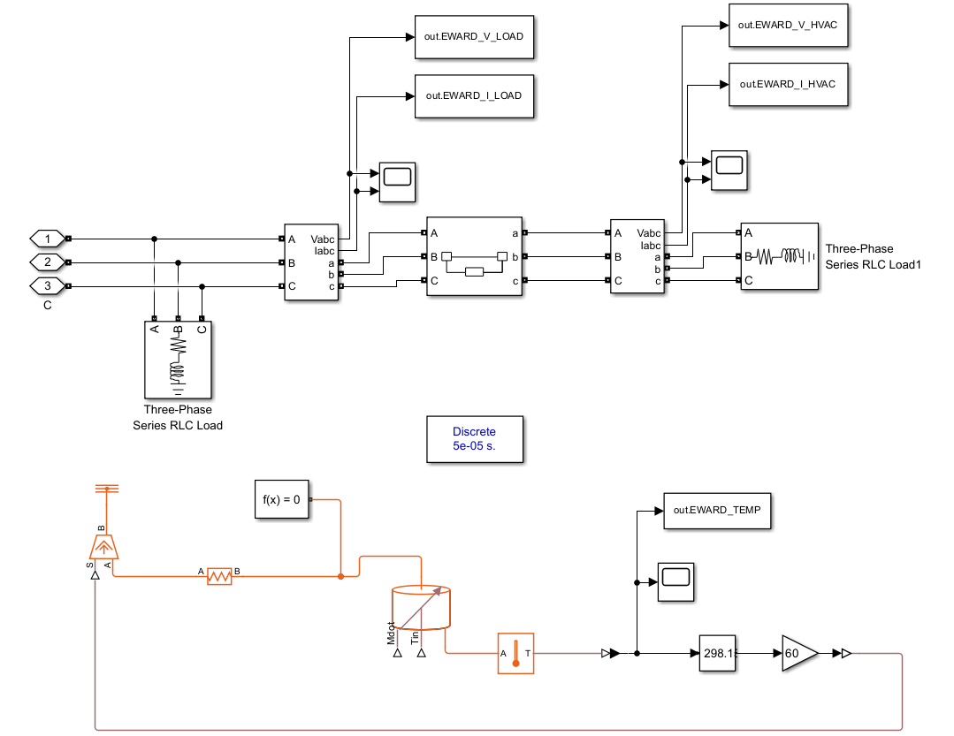
RESULTS - ROOMS
GENERAL WARD EMERGENCY WARD

Slide 19
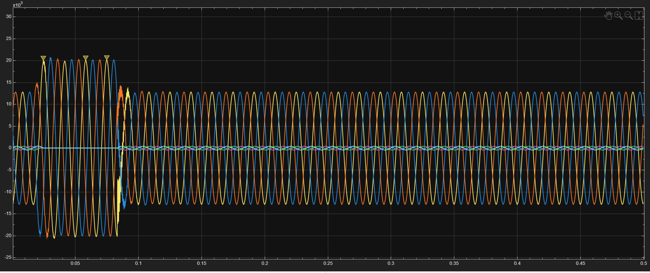
RESULTS - GRAPHS
Scope 1 (Electrical System) : V and I graph after general load

Slide 20
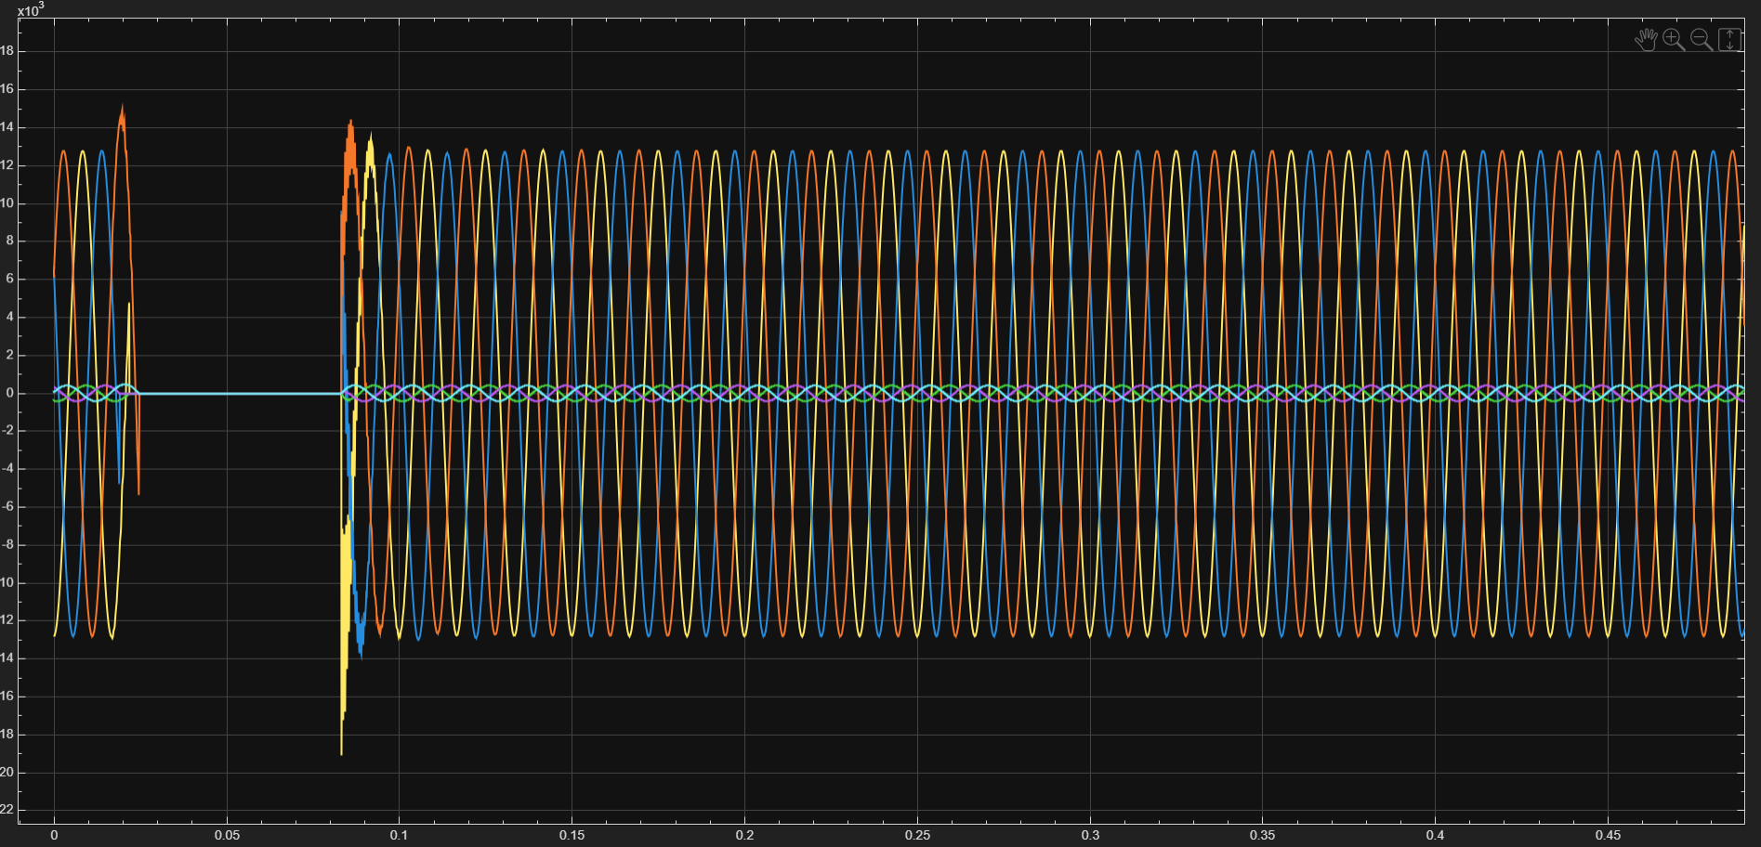
RESULTS - GRAPHS
Scope 2 (Electrical System) : V and I graph after HVAC load

Slide 21
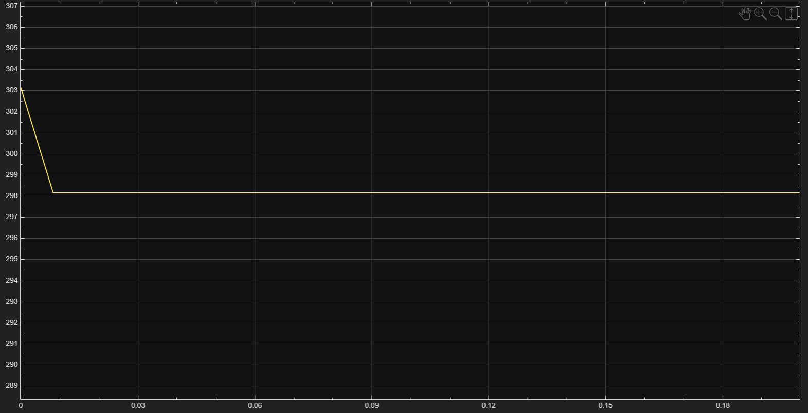
RESULTS - GRAPHS
Scope (Thermal system) – HVAC affecting the temperature

Slide 22
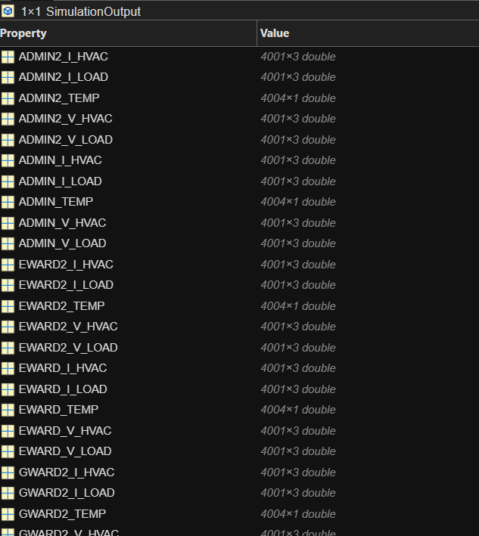
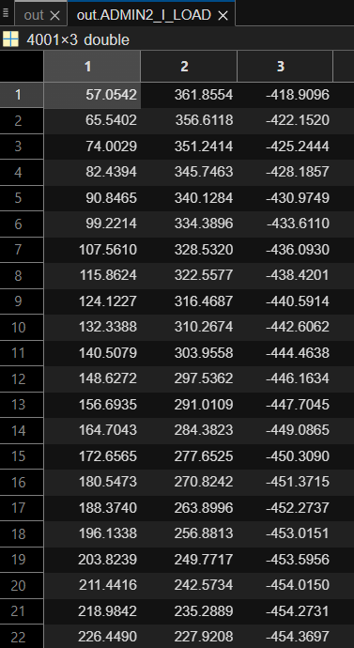
RESULTS – DATA AQUISITION
Data collected from every subsystem / Example data

Slide 23
References
H. Agharazi et al., "Installation and Testing of a Two-Level Model Predictive Control Building Energy Management System," in IEEE Transactions on Control Systems Technology, vol. 32, no. 2, pp. 326-339, March 2024
W. Cai, S. Sawant, D. Reinhardt, S. Rastegarpour and S. Gros, "A Learning-Based Model Predictive Control Strategy for Home Energy Management Systems," in IEEE Access, vol. 11, pp. 145264-145280, 2023
S. S. Tohidi, D. Calì and H. Madsen, "Adaptive Model Predictive Controller for Building Thermal Dynamics," in IEEE Control Systems Letters, vol. 8, pp. 1325-1330, 2024
B. He, N. Zhang, C. Fang, Y. Su and Y. Wang, "Flexible Building Energy Management With Neural ODEs-Based Model Predictive Control," in IEEE Transactions on Smart Grid, vol. 15, no. 5, pp. 4690-4704, Sept. 2024
H. Li, J. Xu and Q. Zhao, "Priority-Based Energy Allocation in Buildings Through Distributed Model Predictive Control," in IEEE Transactions on Automation Science and Engineering, vol. 22, pp. 7516-7529, 2025
B. K. Oleiwi and A. H. Sabry, "Controlling a House’s Air-Conditioning Using Nonlinear Model Predictive Control," in IEEE Embedded Systems Letters, vol. 16, no. 2, pp. 239-242, June 2024
G. Mantovani and L. Ferrarini, "Temperature Control of a Commercial Building With Model Predictive Control Techniques," in IEEE Transactions on Industrial Electronics, vol. 62, no. 4, pp. 2651-2660, April 2015
A. Martinčević and M. Vašak, "Constrained Kalman Filter for Identification of Semiphysical Building Thermal Models," in IEEE Transactions on Control Systems Technology, vol. 28, no. 6, pp. 2697-2704, Nov. 2020

